Slide 1
Preventing and Controlling the Spread of Communicable Diseases, Including Immunizations

Slide 2
Medical Home
Performance Standard
  1302.42 1302.80 (a)
Minimum Standard
  §746.603(3)
Policy Statement:
  UTRGV-PSJA ISD-EHS-CCP Program children must have a medical home within 90 days after the child attends the program. A medical home includes a primary care physician, dentist and or specialist with the corresponding well baby exam, oral exam, immunizations, and tuberculosis screen. UTRGV-PSJA ISD-CCP Program will assist families in accessing and maintaining an up to date medical and dental care. The enrolled pregnant woman will have continuance accessible health care within 30 days.

Slide 3
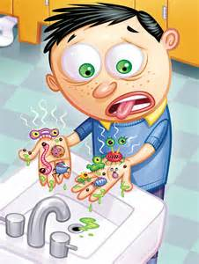
What Are Communicable Diseases?
They are illnesses that spread from one person to another. They are also called contagious or infectious diseases.
Communicable diseases are caused by germs and tiny bugs. The germs are so small that they can only be seen with a microscope, not with the naked eye.
Aggregation in groups can increase and decrease the risk of spread of communicable disease.

Slide 4
The germs and bugs are categorized as:
viruses (e.g., "colds," chicken pox, hepatitis A & B, HIV),
bacteria (e.g., "strep," tuberculosis), or
fungi (e.g., ringworm, thrush), and
parasites (e.g., giardia, pinworms, scabies, head lice).
Illnesses caused by bacteria, fungi and parasites always need medical evaluation and antibiotic treatment. Many illnesses caused by viruses are mild and go away on their own, but some need medical evaluation and treatment.

Slide 5
Types of germs
Virus
  People often get better on their own.
  There is limited treatment, other than rest and control of symptoms
  Bacteria
  Often need to be treated with antibiotics
  Fungus
  Often on surfaces of body and can be treated with creams or oral medication.
  Parasite
  Typically cause diarrhea
  Often need to be treated with antiparasitic medications

Slide 6
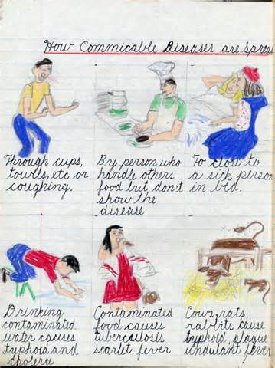
How Do Communicable Diseases Spread?
Germs that cause communicable diseases are found in and on people, animals, food, water, air, and dirt. Most of the germs are carried in human "body fluids" - blood, mucus, saliva, vomit, stool, urine, and discharges from the eyes and skin lesions. Most communicable bugs are carried on the skin and hair.
Notes:
Germs spread when the body fluids of one person get into the body of another person. Most communicable bugs spread by getting onto the skin or hair.

Slide 7
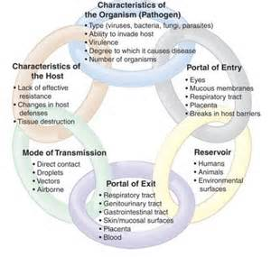
Communicable diseases can be categorized by the way they spread:
Respiratory diseases (e.g., colds) affect the head and chest.
Gastrointestinal diseases (e.g., infectious diarrhea) affect the stomach and intestines.
Dermatologic diseases (e.g., ringworm) affect the skin and hair.
Blood-borne diseases (e.g., hepatitis B) affect the entire body.
Notes:
Respiratory diseases (e.g., colds) affect the head and chest. They are spread by: coughing, sneezing, and breathing, touching nasal mucus, saliva, and eye discharge.
Gastrointestinal diseases (e.g., infectious diarrhea) affect the stomach and intestines. They are spread by:
touching stool, vomit, or contaminated surfaces, eating food
contaminated by stool, drinking or bathing in water contaminated by stool.
Dermatologic diseases (e.g., ringworm) affect the skin and hair. They are spread by: touching skin or hair,
sharing items such as clothes, hats, towels, and hairbrushes that touch skin or hair.
Blood-borne diseases (e.g., hepatitis B) affect the entire body. They are spread by: getting blood onto broken skin, receiving blood transfusions, sharing needles used for injections, piercing, or tattoos,
having sexual contact that shares body fluids.

Slide 8

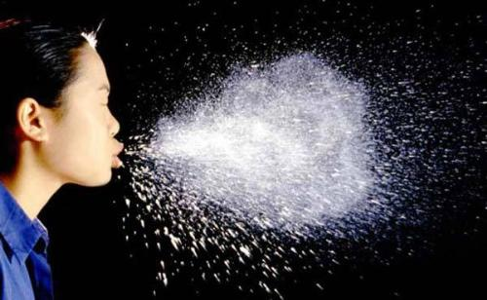
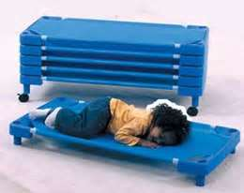
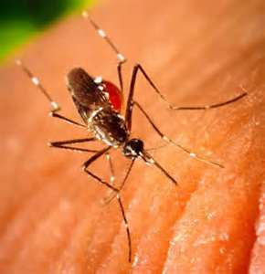
How Pathogens Enter the Body
Direct contact
Indirect contact
Airborne
Vector-borne

Slide 9

Recognize & Managing Communicable Diseases
Recognizing and managing Communicable Diseases involves a partnership among Staff, Families and Health Professionals.
Communication among Staff, Families and Health Professionals plays a key role in preventing & managing Communicable Diseases.

Slide 10


The Role of staff is:
Observe children for signs of Illness.
Care for ill children until they can be sent home.
Document Signs, Symptoms and Actions taken.
Discuss with parents their child's condition, whether he/she is too sick to attend, the need for Medical Evaluation and Treatment, and when they are able to return.

Slide 11
Procedures for Immunizations:
l. Children must have all immunizations up to date prior to the first day of school. Children with deficient immunization records will not be allowed to attend school. Necessary arrangements will be made to assist the parent in acquiring the necessary immunizations as needed. (Minimum Standard 746.613)
2. In the event a child has his/her birthday during the school year, the parent will be sent a Health Notice. The parent will have thirty (30) days in which to comply with the immunizations. All efforts made to assist the parents in acquiring the needed immunizations for their child will be documented in Child Plus and Family Contact Notes.
3. Efforts to assist families throughout the school year in order to update immunizations will include health fairs, establishing clinics or referrals to local health department.

Slide 12
Cont. Procedures for Immunizations:
4. Immunization schedules are to follow the Texas Department of Health Services requirements and comply with the Minimum Standards of the Texas Department of Protective and Regulatory Services.
a. Affidavit request for exemption from immunizations is available at
https://core.quest.dshs.tesxas.gov
5. In the event parent/guardian chooses to not immunize their child for religious or personal beliefs, a notarized affidavit is required and kept in family file. This form will be reviewed and discussed annually with parent/legal guardian.

Slide 13
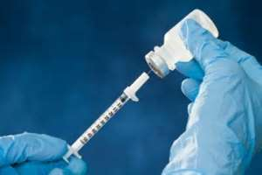

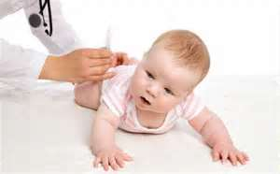

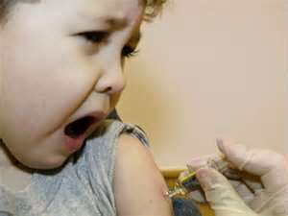
Immunizations
Staff and parents should consult their Health Care Provider about the following Immunizations: Polio, Measles, Mumps, Rubella, Tetanus, Diphtheria, Hepatitis B, Influenza, Pneumococcal, and Chicken Pox.
Note: New Immunizations can become available at any time, consult your Local Public Health authorities to learn the most current recommendations or log on to www.cdc.gov/vaccines.
Notes:
How do you check vaccine records? 1. compare to CDC chard 2. PROMIS Why should we check if records are UTD? Because it’s required. Because it can save the life of a child by preventing diseases. Because having immunizations lessens the risk of other children getting a communicable disease. Why are so many children overdue for vaccines 1. Because parents don’t take them to get immunized. 2. Because some parents do not believe in immunizing their children.

Slide 14
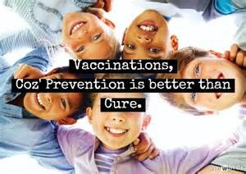
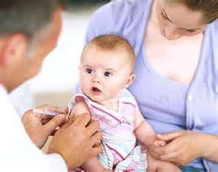
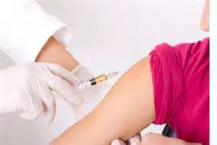
Preventing the Spread of a Communicable Disease
It is important to ensure that you receive vaccinations for Communicable Diseases. Stay current with Flu shots by receiving one annually. This will allow your body the Antibodies necessary to combat these Diseases should you ever become infected by them.
Notes:
How do you promote flu vaccine use? Examples: Parent education. Explaining benefits of flu shot.

Slide 15
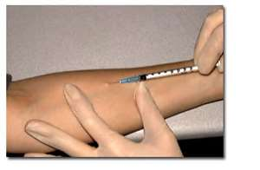
Tuberculin (TB)
Tuberculosis (TB) is a Communicable Disease that can cause Cough, Pneumonia, Fevers, Weight Loss, and even Death.
Young children, seniors, and people with health problems are especially at risk.
TB spreads by Coughing.
The infection enters the lungs and may cause no symptoms for years.
One third of the world’s population is infected with TB.
2 million deaths a year.

Slide 16
Tuberculin (TB)
Transmission of Tuberculosis is a three step process:
    Transmission of bacteria
    Establishment of infection
    Progression to disease

Slide 17
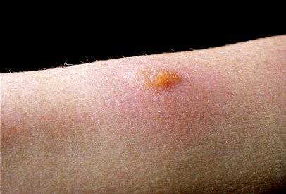
TB Infection versus Disease
Infection (Goal= to prevent future active disease)
    TB infection
    No disease
    Not sick
    Not infectious
Active TB (Goal =treat to cure, prevent transmission)
    TB infection which has progressed to TB disease
    Sick
    Infectious

Slide 18
Diagnosis of TB Disease:Symptoms
    Pulmonary TB Disease
      Coughing
      Pain in the chest when breathing or coughing
      Coughing up sputum or blood
    General TB Disease
      Weight loss
      Fatigue
      Malaise
      Fever
      Night Sweats

Slide 19
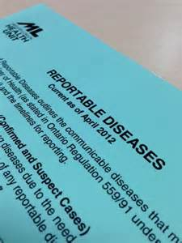
Communicable Disease Reporting Policy
EHS-UTRGV will report all communicable disease in keeping with local, tribal and state regulations

Slide 20

OSHA Regulations
OSHA, the Occupational Safety & Health Administration, issued the Occupational Exposure to Blood borne Pathogens regulations (29CFR part 1910.10300 to protect employees by reducing or removing hazards of blood borne pathogens form the workplace.
The regulation applies to employers whose employees, as a result of job requirements, have the potential for exposure to blood borne pathogens.

Slide 21

OSHA Regulations
By proving safeguards, such as proper practices, use of protective equipment, and training. OSHA believes that disease transmissions can be minimized and lives saved.

Slide 22
OSHA Requires
All employees “at risk” of exposure to Blood Borne Pathogens to receive training at least once per year, plus training whenever required safety procedures change. Training should cover:
The content of OSHA’s Blood Borne Pathogens Standard.
Explanation of Epidemiology.
How Blood Borne Pathogens are transmitted.
Engineering controls, work practices, PPE to eliminate or reduce exposure.
Hepatitis B Vaccine.
Emergency Response involving Blood or Infectious materials
Reporting Incidents.
Warning signs and labels.

Slide 23
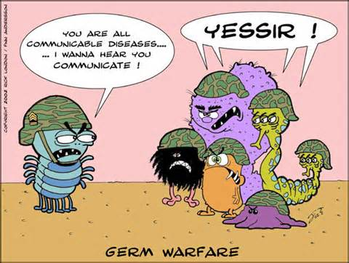
Prevention of Communicable Diseases
More often, preventing Communicable Disease is accomplished through attention to Hygiene, Proper Lifestyle and General Cleanliness.

Slide 24
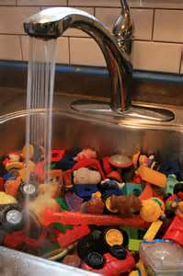
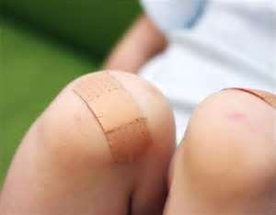
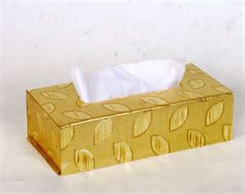
Preventing the Spread of a Communicable Disease
Cover all open wounds.
Dispose of all used tissues by placing them into a sealed plastic garbage.
Wash commonly-used items, such as toys and eating utensils, using hot water and soap.

Slide 25

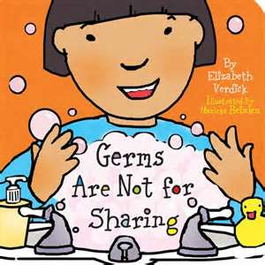
Preventing the Spread of a Communicable Disease
Maintain a strong immune system by incorporating proper nutrition, rest and daily exercise into your lifestyle.
Do not share drinks, toothbrushes or eating utensils with other individuals.

Slide 26

Children
Children in Large group settings-are more prone to Infection
Germs spread more easily in a group setting.
Young children have not yet developed natural resistance.
Several Communicable Diseases are contagious before symptoms appear, making it difficult to prevent their spread.

Slide 27
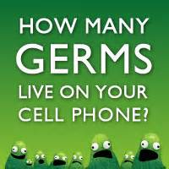
“Catching”a Communicable Disease
It means a Germ has invaded their body.
Germs fear soap and water.
Washing your hands well and often is the best way to beat these tiny warriors.

Slide 28
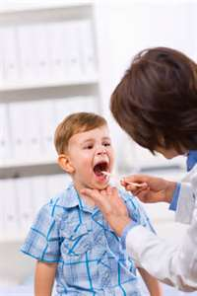

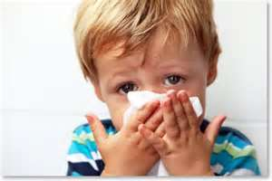
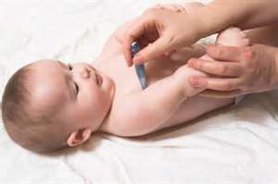
What is a Germ?
In fact, Germs are so tiny that you need to use a microscope to see them. We may not know what hit us until we have symptoms (runny nose, cough, sore throat, fever, etc.) that let us know we've been attacked!

Slide 29
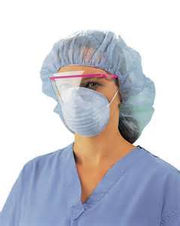
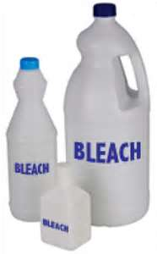
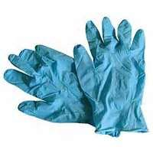
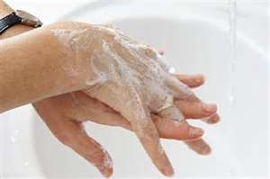
Disease Transmission
Protective Equipment (gloves/masks)
Personal Hygiene Practice (hand-washing)
Engineering & Work Practice Controls
Equipment for Cleaning & Disinfecting

Slide 30
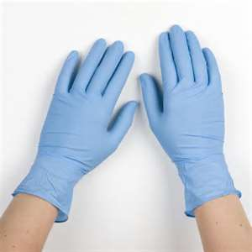
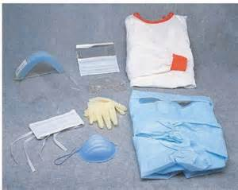
Body Substance Precautions
Body Substance Precautions-refer to the consistent use of barrier methods to prevent direct contact with the body fluids of another person. Gloves are worn to prevent contact with non-intact skin, moist mucous membranes, and body fluids; masks and eye protection are worn when there is a chance of splashing body fluids into the eyes, nose or mouth; gowns are worn if there is a chance that clothing may become soiled with body fluids.

Slide 31
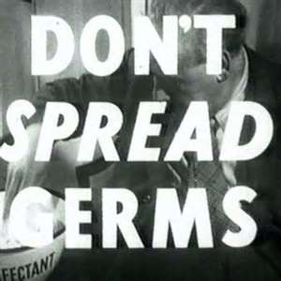
Hand Washing
Diligent hand-washing is perhaps the easiest and most effective method of Preventing Communicable Disease. Numerous Flu-causing Germs and Viruses are passed into the nose, mouth, eyes or ears via the hands that can be removed through soap and water.

Slide 32
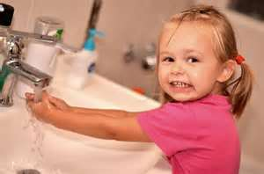
Hand Washing
Germs and Viruses commonly reside on public objects (doorknobs, handrails, counters) as well as household objects, pets, appliances and certain foods.
Wash your hands according to the Hand Washing procedure.

Slide 33

Cleaning & Disinfecting
Surfaces is one of the most important ways to ensure that communicable diseases are not spread. Proper cleaning reduces the number of germs or microorganisms available to cause illness or inction.
4 step process
Wash with water and soap
Rinse with clear water,
Soaking in or spraying on a disinfecting solution (2minutes)
Allow the surface to air-dry.

Slide 34
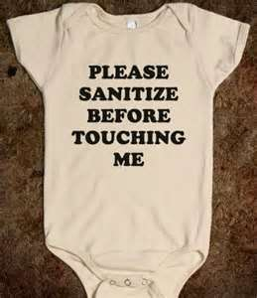
Protecting Children from Disease Transmission
The following needs to be sanitized:
Mouth toys
Sleeping equipment
Potty chairs
Table tops
Diapering tables
Water tables

Slide 35
Controlling Infection –Places/Environment
Facility Design
  Enough space to prevent crowding
  Surfaces easily cleanable
  Separation of food areas from toileting and diapering areas
  Enough flushing toilets and well-designed diaper-changing stations

Slide 36
Protecting yourself from Disease Transmission
Exposure Control Plan:
  Exposure Determination
  Schedule & Methods for implementing OSHA Standards
  Procedures for evaluating exposures

Slide 37
Q & A

